Slide 1
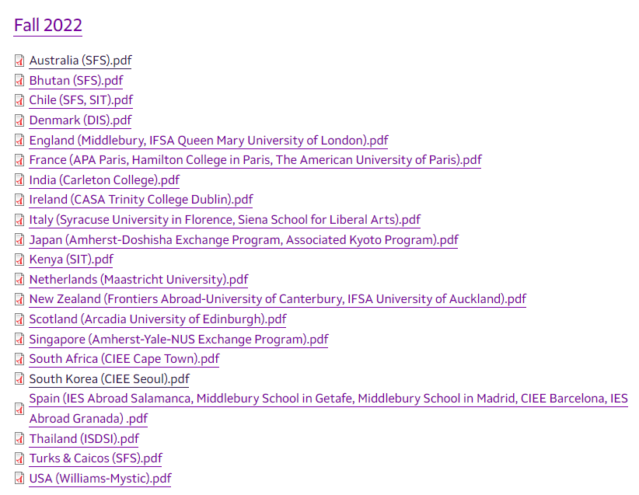
What we learned from the customer
Currently:
GEO Office posts PDFs of student program evaluations
Problem:
Difficult for students to search for specific info.
Customer’s Request:
Searchable database whereby students could search student evaluations on various factors.

Slide 2
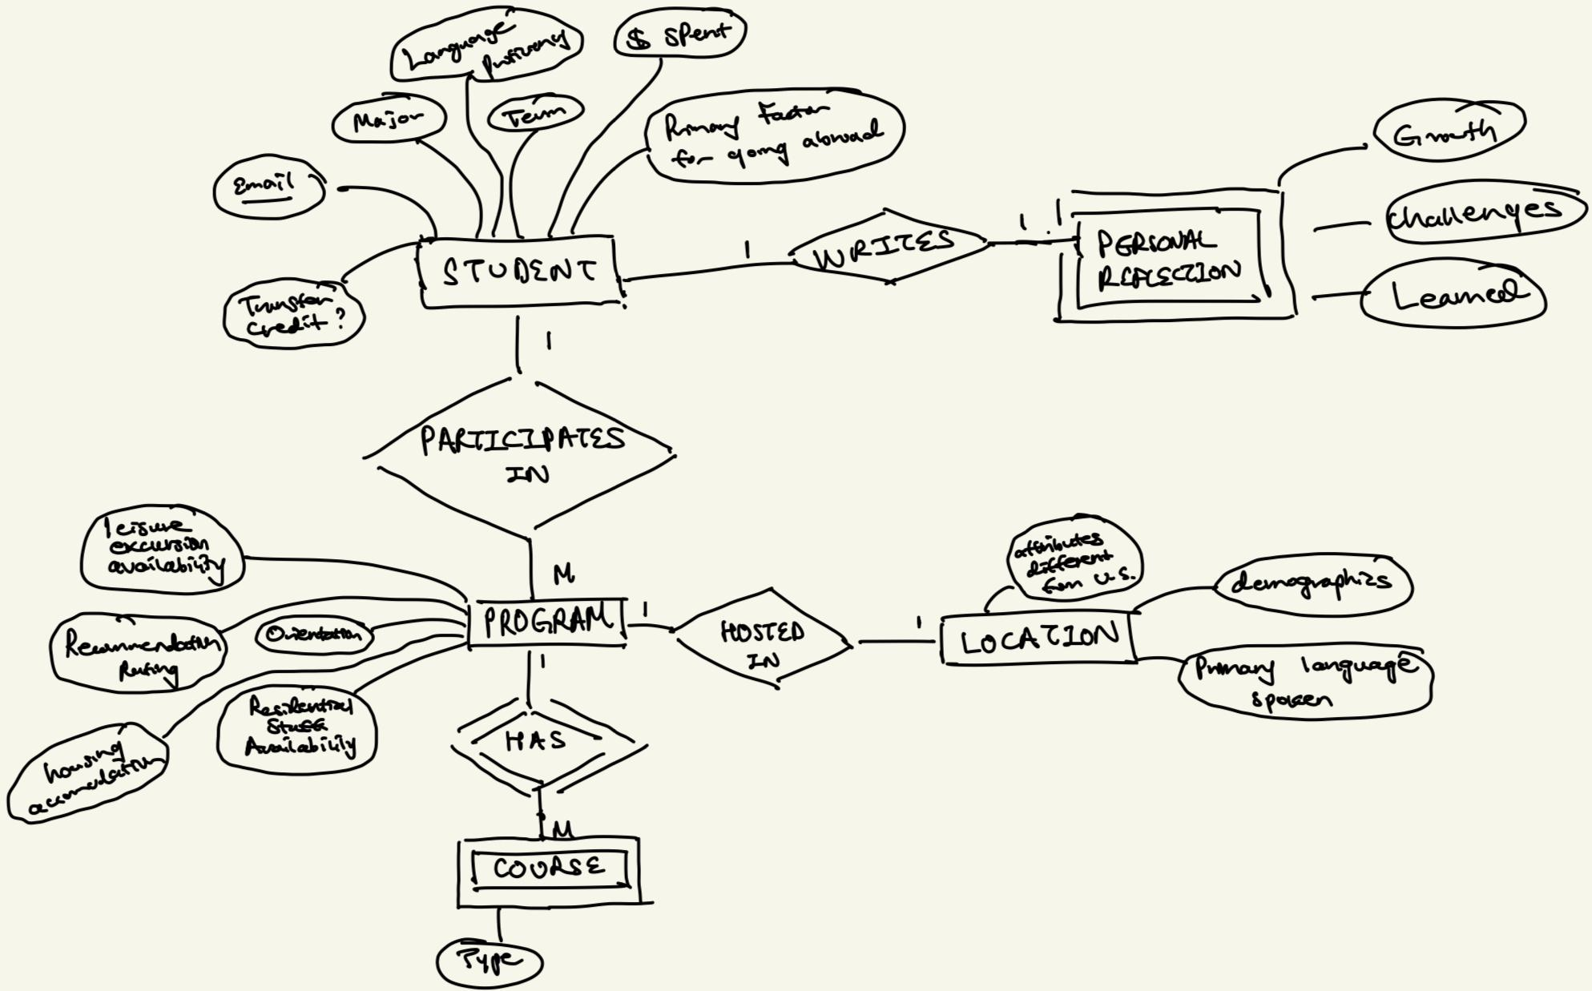
ER diagram

Slide 3
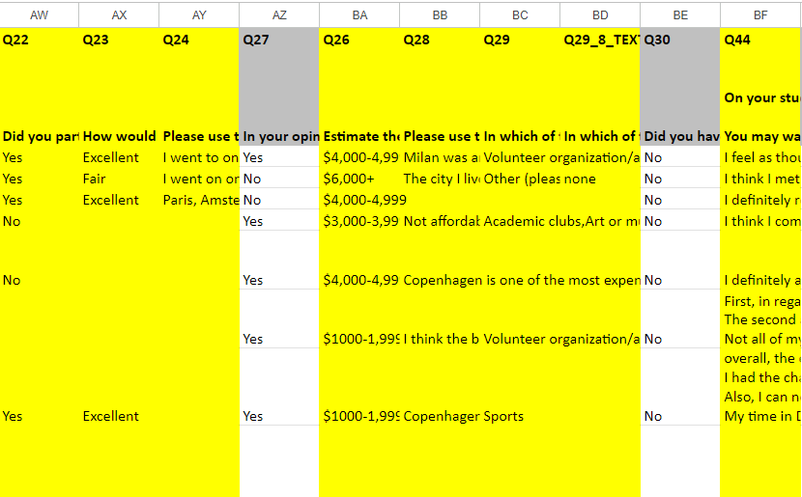
The data we’re working with
Program evaluation form responses, including:
Academic satisfaction
Extracurricular experiences
Reflection on study abroad goals
Personal growth, etc…
Both quantitative and qualitative data
Collected with Qualtrics, stored in an Excel file

Slide 4
Deliverable : Two Page Application
Public Page:
Authentication - only for Amherst students
Filter by important factors (host country, language spoken, program, price, etc.) & keyword search
Display those factors from student responses (some data omitted from public)
Link/Toggle to view rest of the responses
Admin Page:
View all data, including that hidden from public page
Summary statistics page
Question: What other functionalities would you want?

Slide 5
What we don’t know yet
The most important summative information to display
Keyword Search – what specifically they mean by keyword
Tech stack we plan on using:
Front End: React
Backend: Flask, PostgreSQL
+?

Slide 6
Next steps
Itinerary (short & long term)
Short Term:
Another meeting with the office for clarification on:
Functionalities
Security/Authentication
Confirm ER Diagram
Long Term:
Familiarize ourselves with the tech stack
ER Schema and Relational Schema (Due 10/18)
Determine most important information to design an elegant evaluation summary

